Slide 1

Introduction to AI and machine learning
Pablo Tejeda
Computer Science 131 – Fall 2024

Slide 2
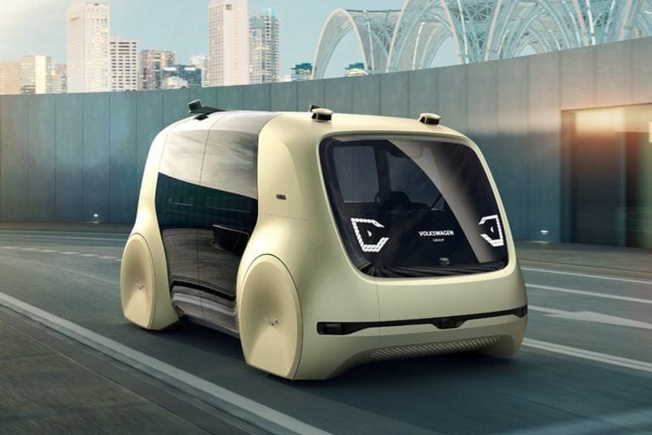
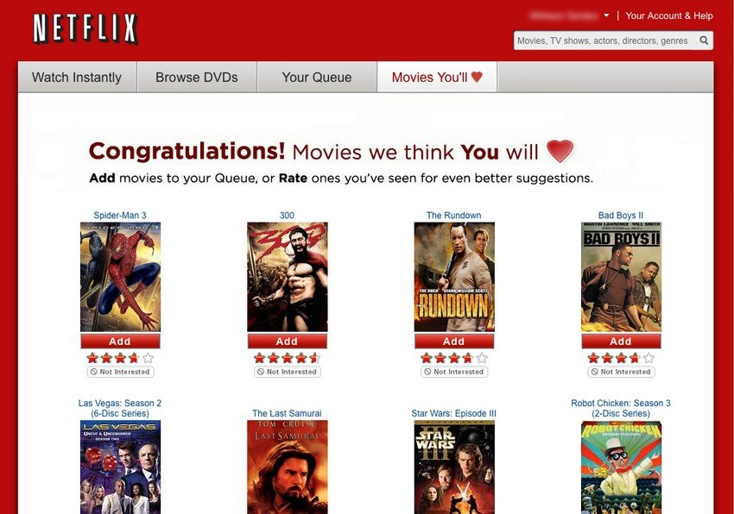
What artificial Intelligence and machine learning
Artificial Intelligence
Artificial Intelligence refers to creating systems that mimic human intelligence
.
Machine Learning
Machine Learning is a subset of AI focused on enabling systems to learn from data.
Autonomous Vehicles
Recommendation Systems

Slide 3
Types of machine learning
Supervised Learning
Learning with labeled data, where the model is trained on input-output pairs.
Types: Predicting house prices, image classification.
Unsupervised Learning
Learning with unlabeled data, where the model identifies patterns or groups.
Types: Customer segmentation, recommendation systems.
Reinforcement Learning
Learning through interaction with an environment, optimizing actions to
maximize rewards.
Types: Robotics, game AI,

Slide 4

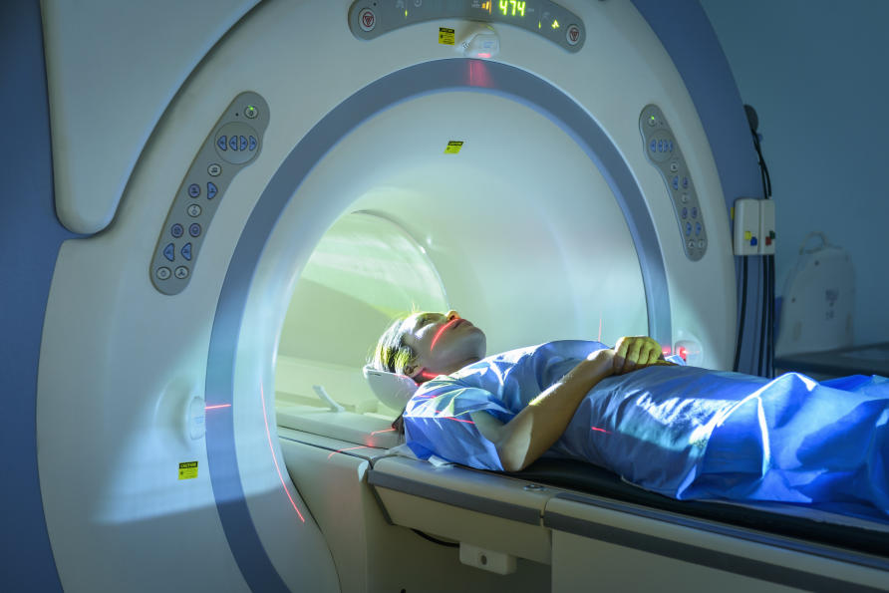
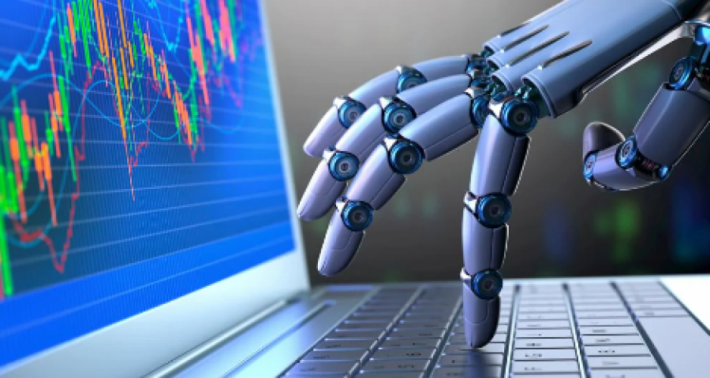
Applications of AI and Machine Learning
E-commerce
Healthcare: Disease diagnosis, drug discovery, patient care.
E-commerce and Marketing: Product recommendations, targeted ads
.
Autonomous Vehicles: Self-driving car technology.
Finance and Banking: Fraud detection, automated trading
.
Natural Language Processing: Chatbots, voice assistant
Medical Imaging
Automated Trading

Slide 5
Artificial Intelligence Ethics and Challenges
Ethical Issues
Bias and Fairness: Potential for perpetuating discrimination.
Privacy Concerns: Risks around personal data usage.
Transparency and Accountability: Need for explainable models.
Job Displacement: Economic impact on certain industries.
Technical Challenges
Data Quality: Importance of accurate and accessible data.
Interpretability: Complexity of understanding model outputs.
Computational Resources: High demands on processing power.
Scalability: Ensuring performance across diverse use cases.

Slide 6
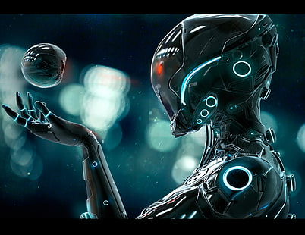
The future of artificial intelligence
Explainability and Trust: More transparent and understandable models.
Ethics and Regulation: Establishing global ethical standards.
AI for Social Good: Applications in healthcare, climate action, and more.
Human-AI Collaboration: Augmenting, not replacing, human roles.
Sustainability: Reducing AI’s environmental impact.

Slide 7

Demonstration of Linear Regression with C++
This is a live demonstration of a C++ implementation of linear regression using gradient descent.
We will adjust the model's slope and intercept iteratively to minimize the Mean Squared Error.
Gradient Descent:
Iteratively adjusts the slope (m) and intercept.
Error Calculation:
Mean Squared Error (MSE) is calculated to measure model performance.
Prediction:
Final prediction for 6 hours of study will be displayed.

Slide 8
Summary of Linear Regression Demonstration
Model Performance:
Gradient descent successfully adjusted slope and intercept values.
Mean Squared Error decreased over iterations.
Final Prediction:
Predicted score for 6 hours of study was calculated.
Learning Process:
Gradient descent efficiently minimized the error.
Error Reduction:
MSE decreased, indicating improved model performance.

Slide 9
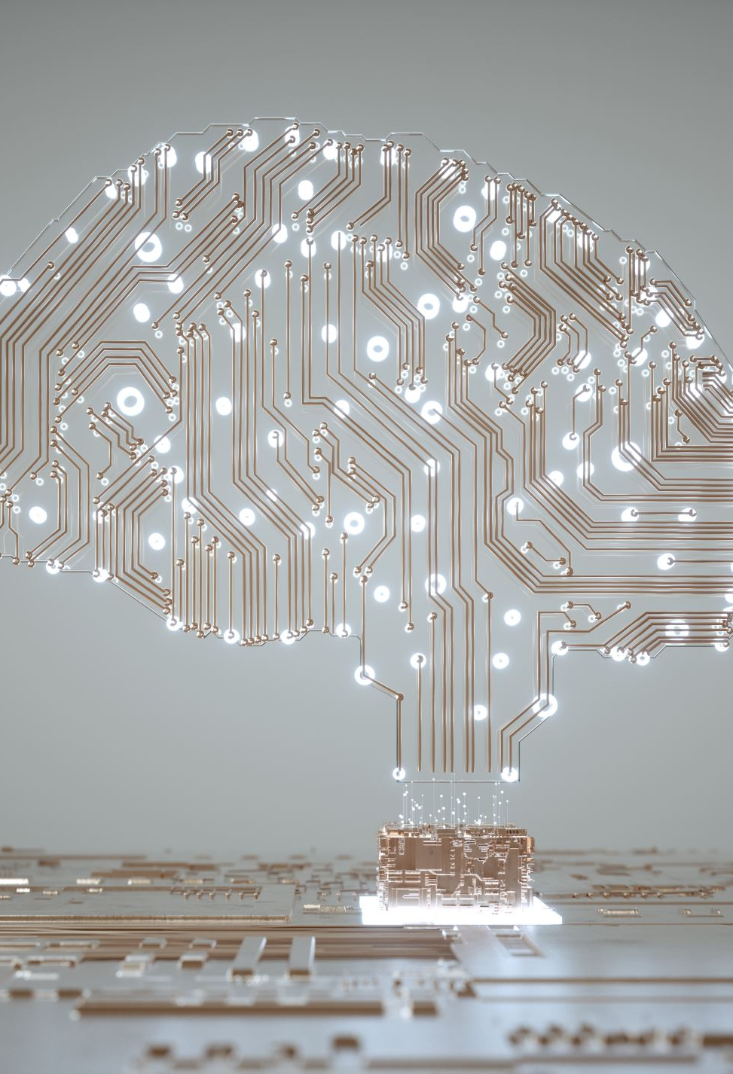
Conclusion and Key Takeaways
What is AI and ML?
AI enables machines to simulate human intelligence. ML is a subset of AI focused on learning from data to make predictions or decisions.
Types of Machine Learning:
Supervised, Unsupervised, and Reinforcement Learning.
Applications of AI:
Transforming fields like healthcare, finance, and transportation.
Ethics and Challenges:
Key concerns include bias, privacy, and job displacement.
The Future of AI:
Emphasis on responsible development and global impact.
Final Thought:
As we continue to advance AI technology, we must ensure it remains a positive force, fostering responsible and ethical growth to benefit all of society.

Slide 10
Thank You

